Slide 1
The True Meaning behind “Decision Day”
Edward Gates, Jr.
Philip Nunoo
Nikita Jones
Mason Waters

Slide 2
Summary
Our project will analyze and compare the starting salaries of students with the same major, comparing the earnings of those who attended college institutions with higher tuition rates versus those who attended college institutions with lower tuition rates
We are seeking to discredit the perception that higher tuition rates result in higher salaries
Based upon analysis of evidence in the form of historical salary outcome data, graduating from institutions with higher tuition rates does not result in higher earnings when compared to graduates from more affordable institutions with the same major

Slide 3

Hypothesis
Graduating from institutions with higher tuition rates does not result in higher earnings when compared to graduates from more affordable institutions with the same major

Slide 4
Questions asked
Does it pay more to attend a Party School or an Ivy League school?
Does region matter in relation to starting salary/mid-career/late-career salary?
What degree majors have higher than average income growth?

Slide 5
Does it pay more to attend a Party School or an Ivy League school?
What classifies as a Party School?
According to Princeton Review‘s annual publication of 62 college ranking
Availability & consumption of alcohol
Availability & consumption of drugs
Amount of time spent studying outside of the classroom
Popularity of Greek Life (fraternities and sororities)

Slide 6
Does it pay more to attend a Party School or an Ivy League school?
What classifies as an Ivy League School?
8 private universities located in the "Northeast" region:
Brown University (Providence, RI)
Columbia University (New York, NY)
Cornell University (Ithaca, NY)
Dartmouth College (Hanover, NH)
Harvard University (Cambridge, MA)
University of Pennsylvania (Philadelphia, PA)
Princeton University (Princeton, NJ)
Yale University (New Haven, CT)

Slide 7
Does it pay more to attend a Party School or an Ivy League school?
What classifies as an Ivy League School?
Common traits:
Academic excellence
Selective admissions process
Sizable financial endowments
Social elitism

Slide 8
Does it pay more to attend a Party School or an Ivy League school?
What schools have two or more classifications?
Party and State: 19
Louisiana State University (LSU)
University of Maryland, College Park
University of Georgia (UGA)
University of Alabama, Tuscaloosa
University of New Hampshire (UNH)
University of Florida (UF)
University of California, Santa Barbara (UCSB)
Pennsylvania State University (PSU)
West Virginia University (WVU)
Indiana University (IU), Bloomington
University of Tennessee
Ohio University
Arizona State University (ASU)
University of Illinois at Urbana-Champaign (UIUC)
University of Texas (UT) - Austin
State University of New York (SUNY) at Albany
Florida State University (FSU)
University of Iowa (UI)
University of Mississippi
Party and Liberal Arts: 1
Randolph-Macon College

Slide 9
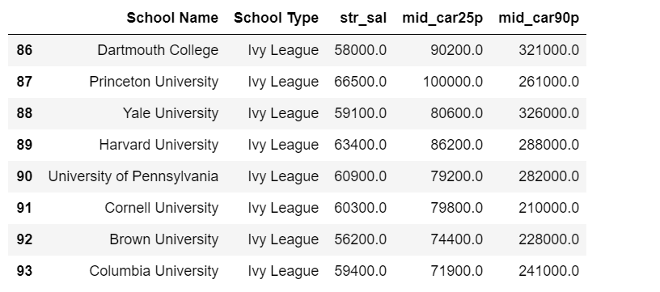
Does it pay more to attend a Party School or an Ivy League school?
What is the average starting salary of Ivy League Schools? (All eight Ivy Schools represented)

Slide 10
Does it pay more to attend a Party School or an Ivy League school?
What is the average starting salary of Ivy League Schools? (All eight Ivy Schools represented)
Brown University: $56,200
Dartmouth College: $58,000
Yale University: $59,100
Columbia University: $59,400
Cornell University: $60,300
University of Pennsylvania: $60,900
Harvard University: $63,400
Princeton University: $66,500

Slide 11
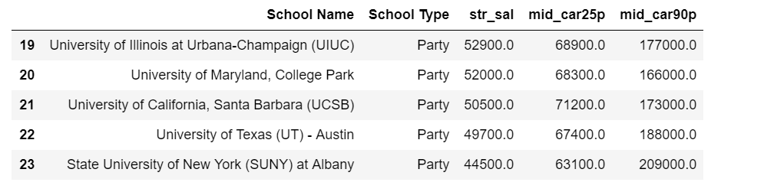
Does it pay more to attend a Party School or an Ivy League school?
What is the average starting salary of Party Schools? (Top Five represented)

Slide 12
Does it pay more to attend a Party School or an Ivy League school?
What is the average starting salary of Party Schools? (Top Five represented)
State University of New York (SUNY) at Albany: $44,500
University of Texas (UT) – Austin: $49,700
University of California, Santa Barbara (UCSB): $50,500
University of Maryland, College Park: $52,000
University of Illinois at Urbana-Champaign (UIUC): $52,900

Slide 13
Does region matter in relation to starting median salary/mid-career median salary?
What are the mean salaries for each region?
Five regions to explore
Western
Midwestern
Southern
Northeastern
California

Slide 14
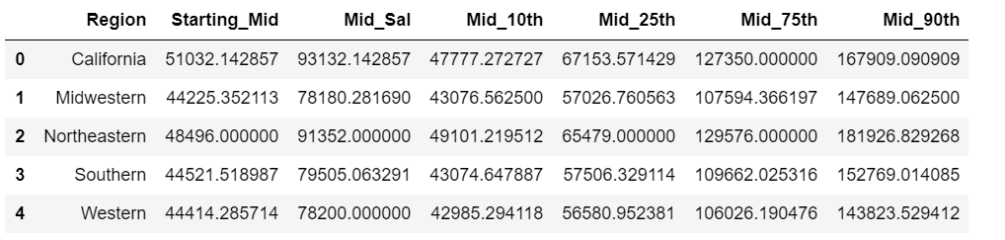
Does region matter in relation to starting median salary/mid-career median salary?
What are the mean salaries for each region?
Which region has the highest starting/mid-career/late-career salary?
Which region has the lowest starting/mid-career/late-career salary?

Slide 15
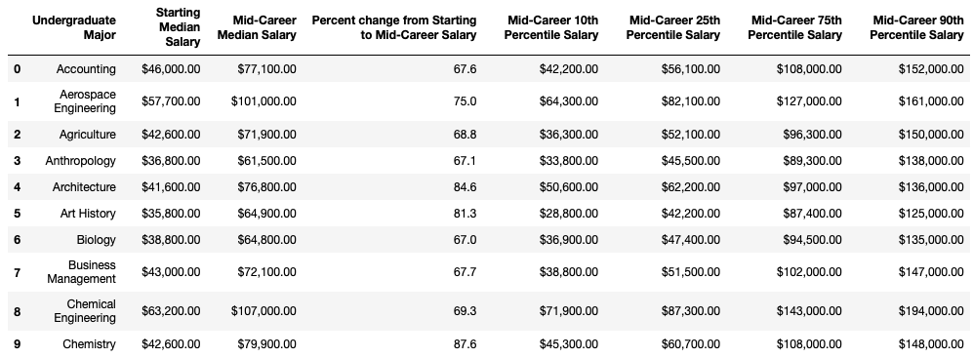
Which degree majors have higher than average income growth?

Slide 16
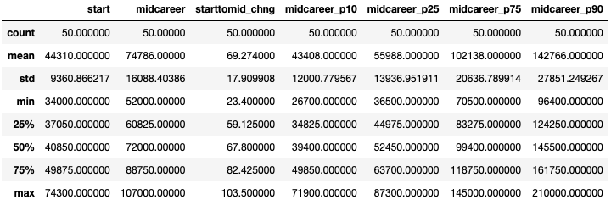
Overall Descriptive Statistics

Slide 17
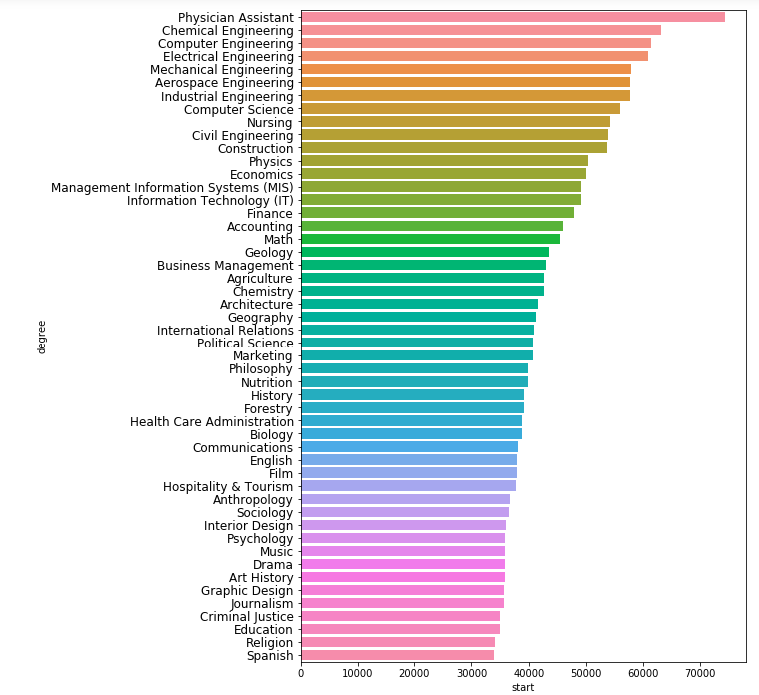
Which Undergraduate Majors get the highest income at the start of their careers?
Top 5
Physician Assistant: $74,300
Chemical Engineering: $63,200
Computer Engineering: $61,400
Electrical Engineering: $60,900
Mechanical Engineering: $57,900
Bottom 5
Spanish: $34,000
Religion: $34,100
Education: $34,900
Criminal Justice: $35,000
Journalism: $35,600

Slide 18
Which Undergraduate Majors get the highest income at Mid-Career?
Top 5
Chemical Engineering: $107,000
Computer Engineering: $105,000
Electrical Engineering: $103,000
Aerospace Engineering: $101,000
Economics: $98,600
Bottom 5
Religion: $52,000
Education: $52,000
Spanish: $53,100
Interior Design: $53,200
Music: $55,000

Slide 19
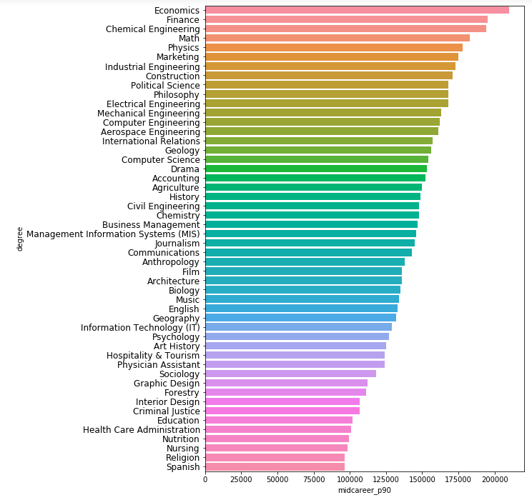
Which Undergraduate Majors get the highest income at Mid-Career 90th Percentile?
Top 5
Economics: $210,000
Finance: $195,000
Chemical Engineering: $194,000
Math: $183,000
Physics: $178,000
Bottom 5
Spanish: $96,400
Religion: $96,400
Nursing: $98,300
Nutrition: $99,200
Healthcare Administration: $101,000

Slide 20
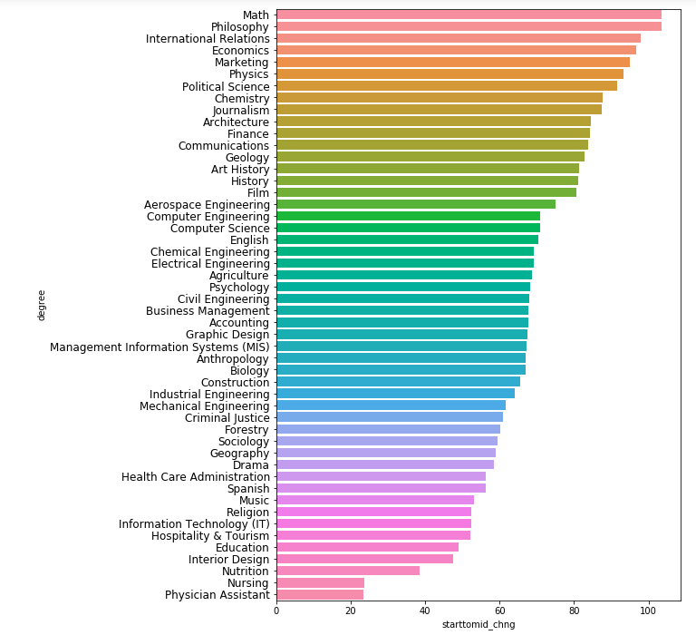
Percent change from Starting to Mid-Career Salary
Top 5
Math: 103.5%
Philosophy: 103.5%
Economics: 97.8%
Marketing: 96.8%
Physics: 95.1%
Bottom 5
Physician Assistant: 23.4%
Philosophy: 23.4%
Economics: 38.6%
Marketing: 47.4%
Physics: 49%

Slide 21
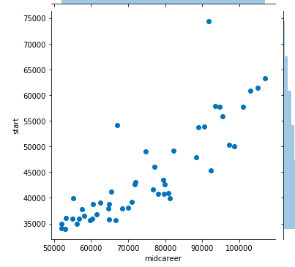
Starting vs. Mid-Career Median Salary
Pearson Correlation: 0.85

Slide 22
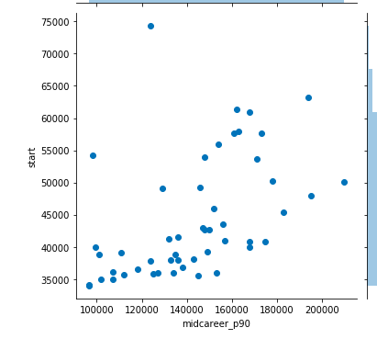
Starting vs. Mid-Career 90th Percentile Median Salary
Pearson Correlation: 0.70

Slide 23
Degree Majors Summary
Physician Assistants start their career noticeably with the best salary.
In the middle of the career, Chemical Engineers and then Computer Engineers get the best salary.
In the long term, Economists have the salary advantages who earns the best salary when compared to others.
Mathematicians and Philosophers have the most increase in their salary during their career.
As a result of analyzes we have made, different jobs have different advantages in their career opportunities when start salary, long term salary and increase in salary percentage compared.

Slide 24
?
Any questions?
?
?

